Slide 1
Business Analytics Job Market Analysis Updates
May 2023
Yini Rong

Slide 2
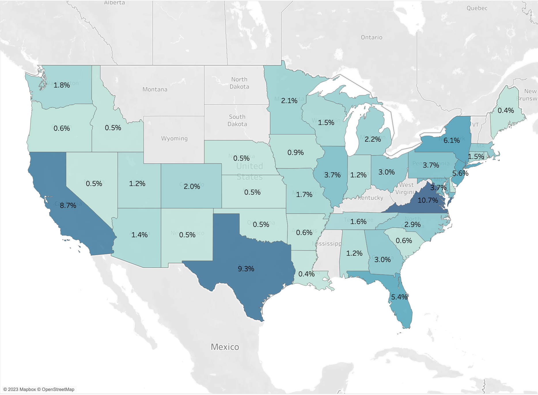
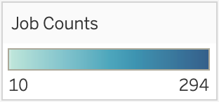
Job Market Analysis – by U.S. States
Business Analytics Related Full Time Job Positions by U.S. States
These job positions were full-time entry level positions in three analytical domains:
General / Data Analytics
Data Science
Data Engineering
This includes 2,908 posts in total from LinkedIn in March 2023.
There were 72 remote positions.

Slide 3
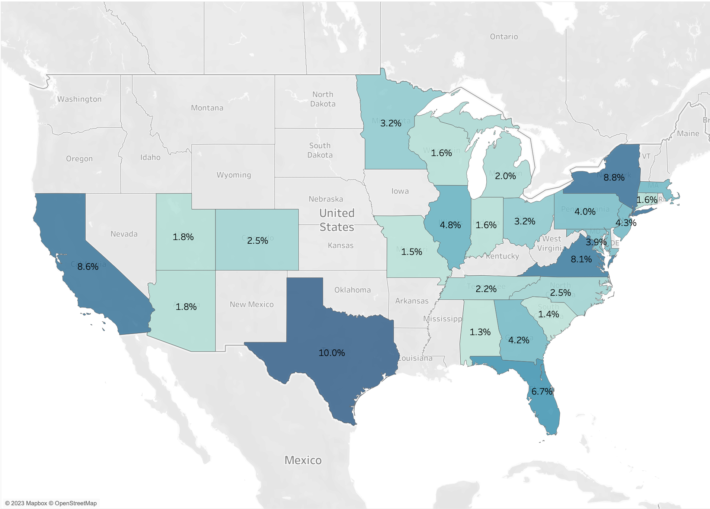
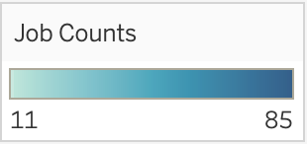
Job Market Analysis – by U.S. States
General Analytics Full Time Job Positions by U.S. States
These job positions were full-time entry level positions in General Analytics. Some of the titles include “Data Analyst,” “Business Analyst,” “Web Analytics Analyst,” “BI Analytics Specialist,”” Business Intelligence Analyst,” “Operations Data Analyst,” “Insurance Data Analyst,” etc.
990 job postings in March 2023 were collected from LinkedIn.

Slide 4
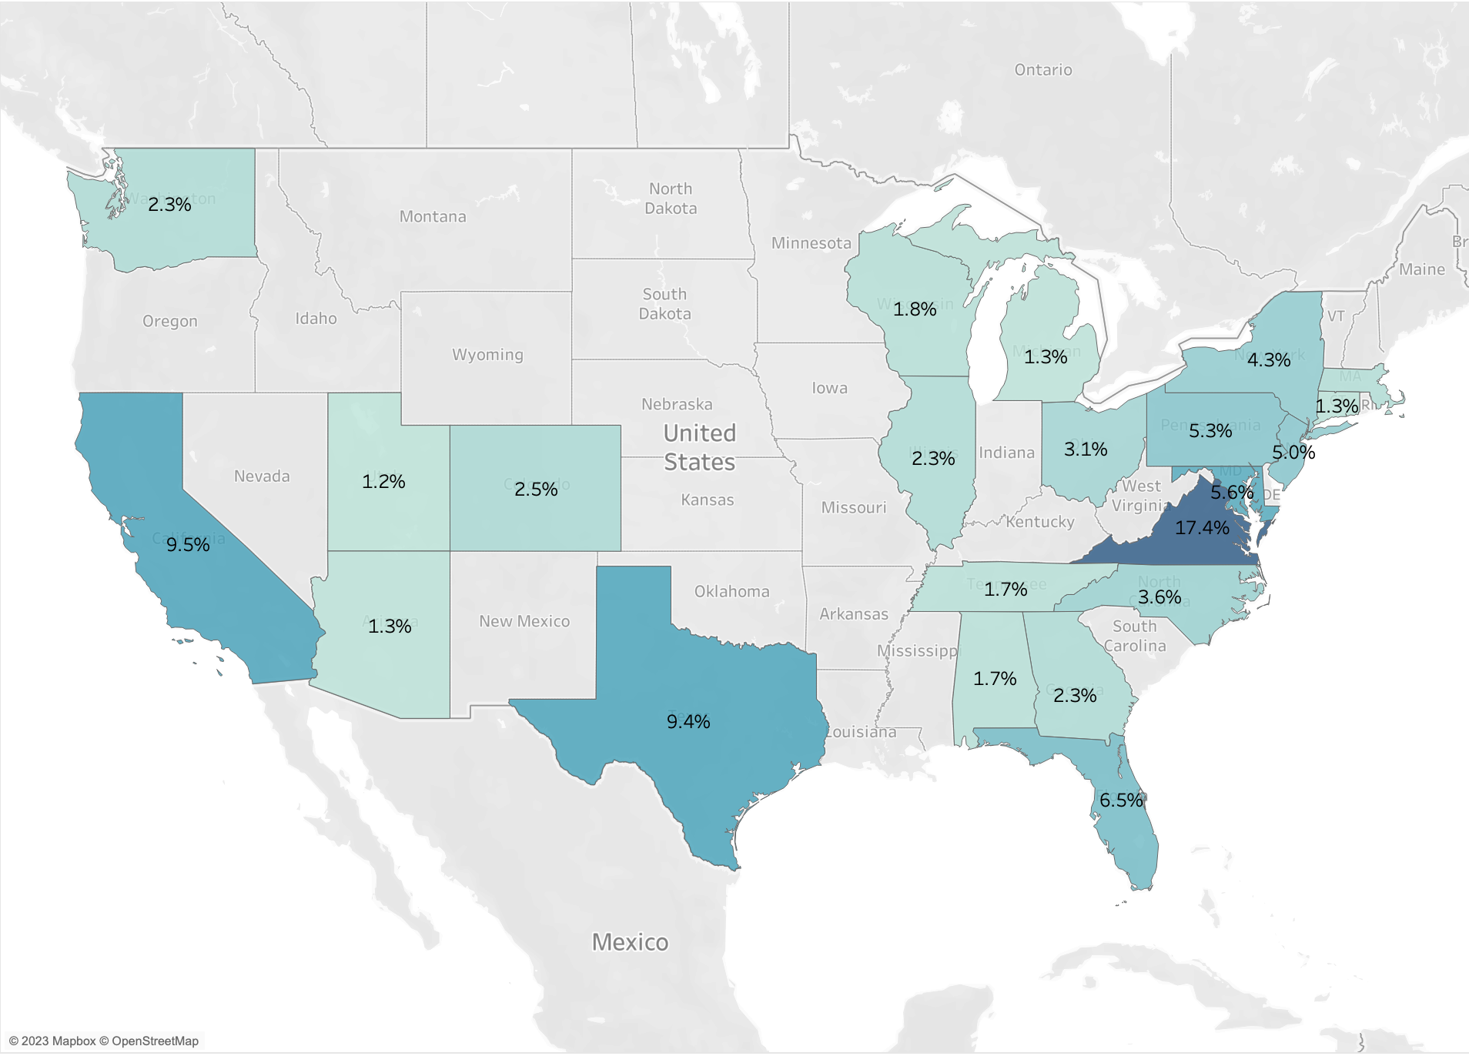

Job Market Analysis – by U.S. States
Data Science Full Time Job Positions by U.S. States
These job positions were full-time entry level positions in Data Science. Job titles are mainly “Data Scientist.”
928 job postings in March 2023 were collected from LinkedIn.

Slide 5
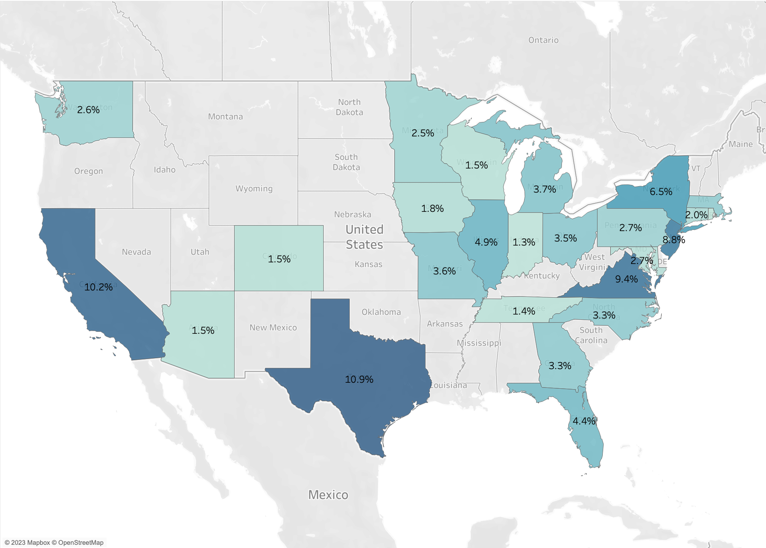
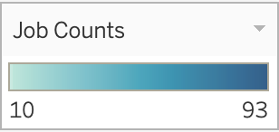
Job Market Analysis – by U.S. States
Data Engineering Full Time Job Positions by U.S. States
These job positions were full-time entry level positions in Data Engineering. Job titles are mainly “Data Engineer.”
990 job postings in March 2023 were collected from LinkedIn.

Slide 6
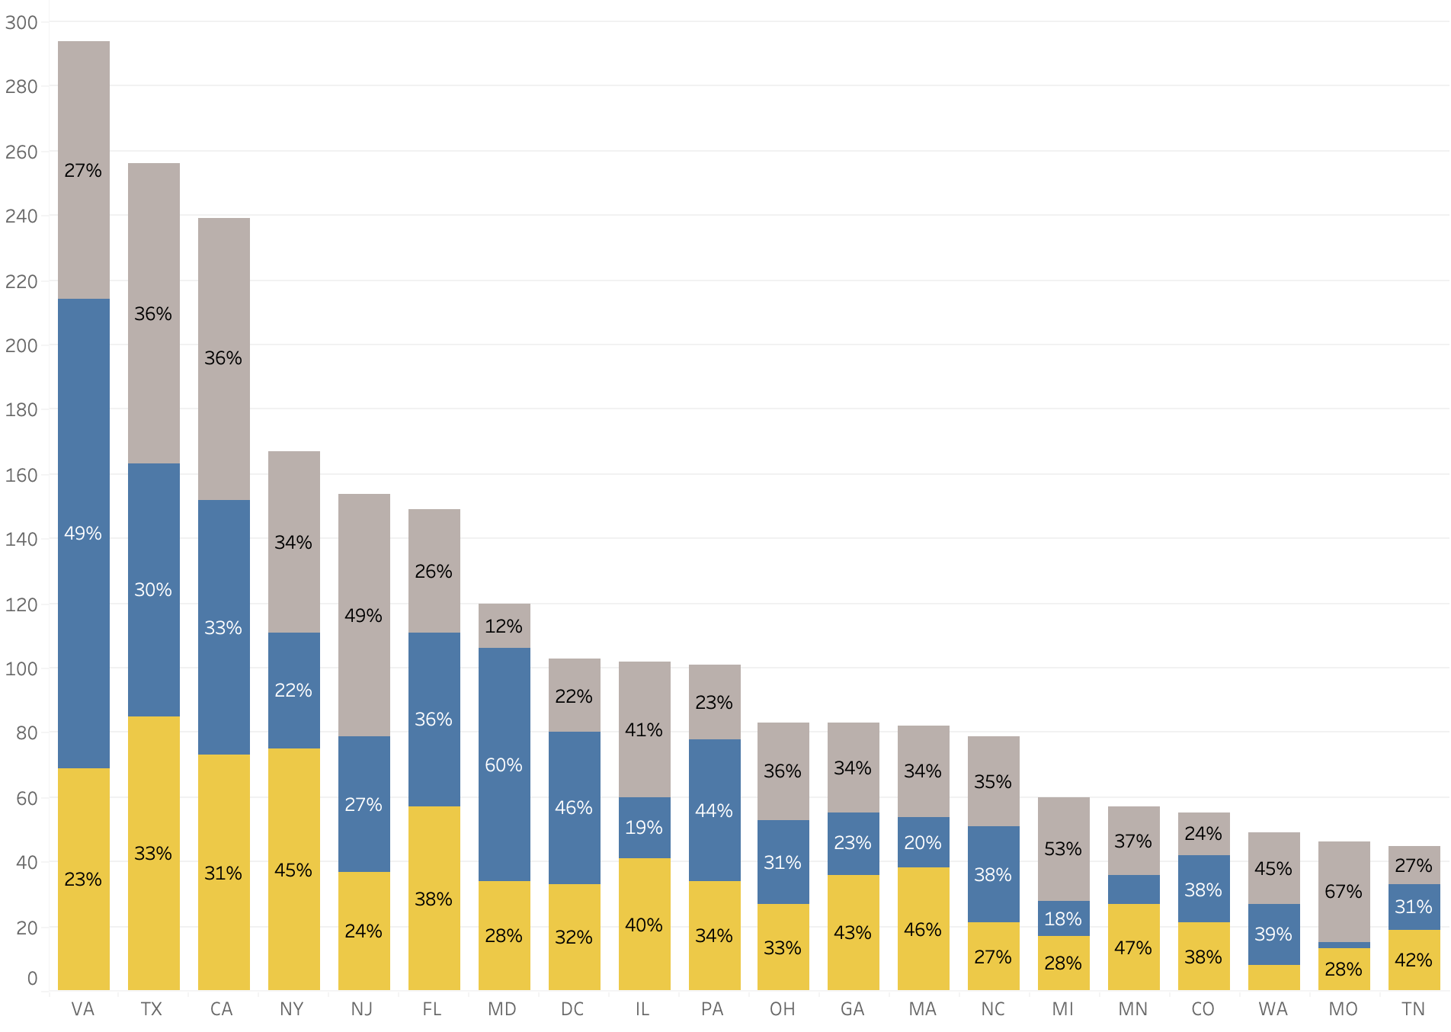
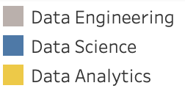
Job Market Analysis – by U.S. States
Full Time Job Positions by Three Domains in Each State

Slide 7
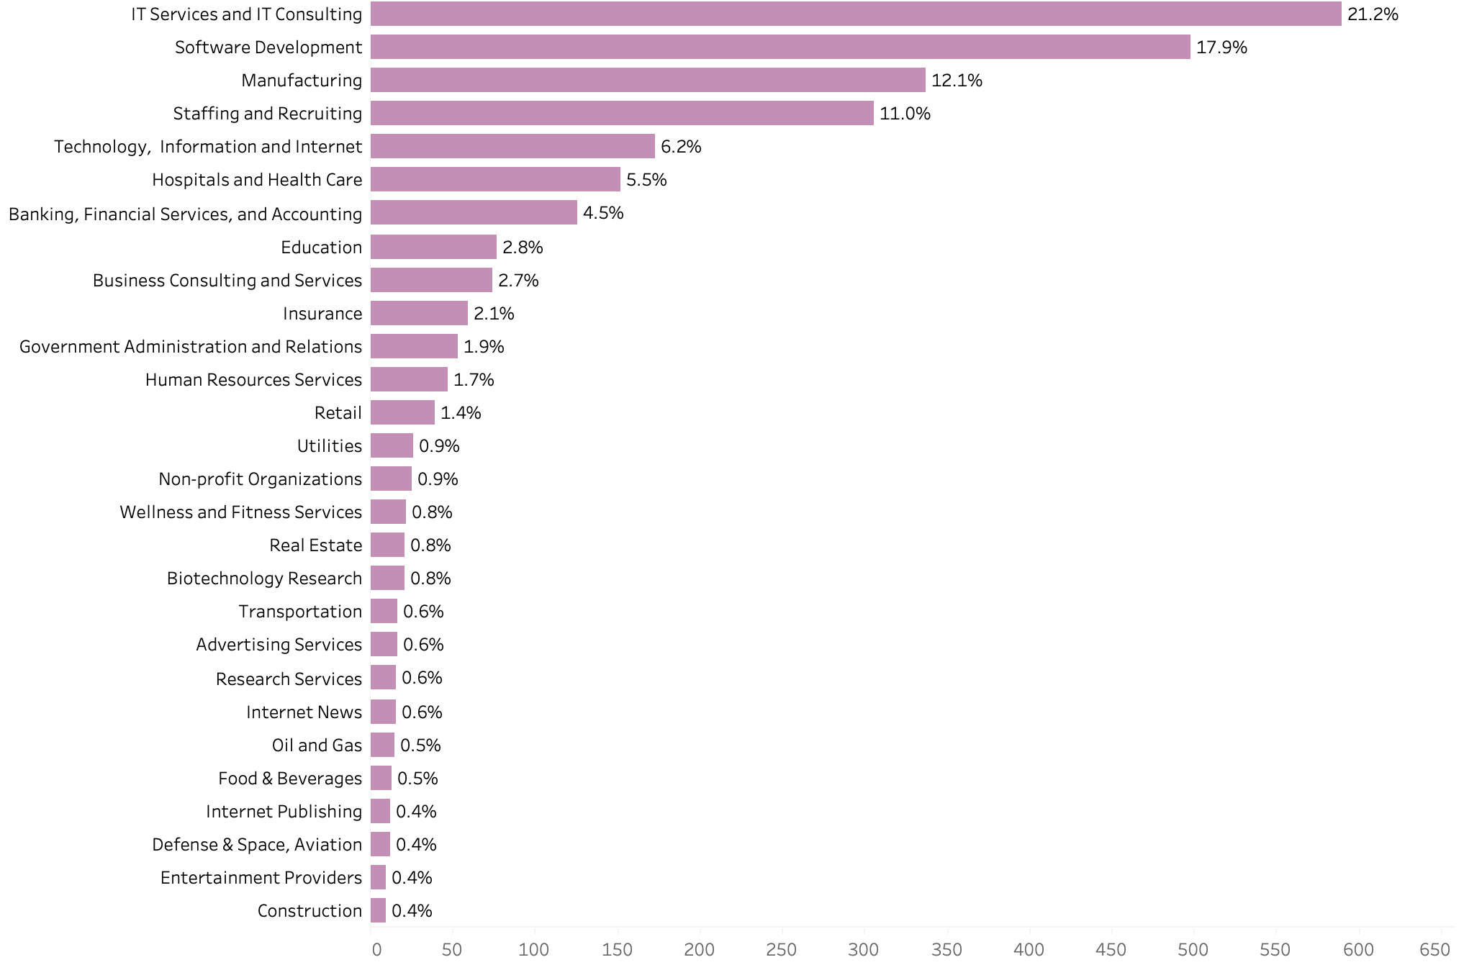
Job Market Analysis – by Industry
Business Analytics Related Full Time Job Positions by Industry
Note: Similar industries are consolidated into a single industry. Chart shows industries with at least 10 jobs in March 2023.

Slide 8
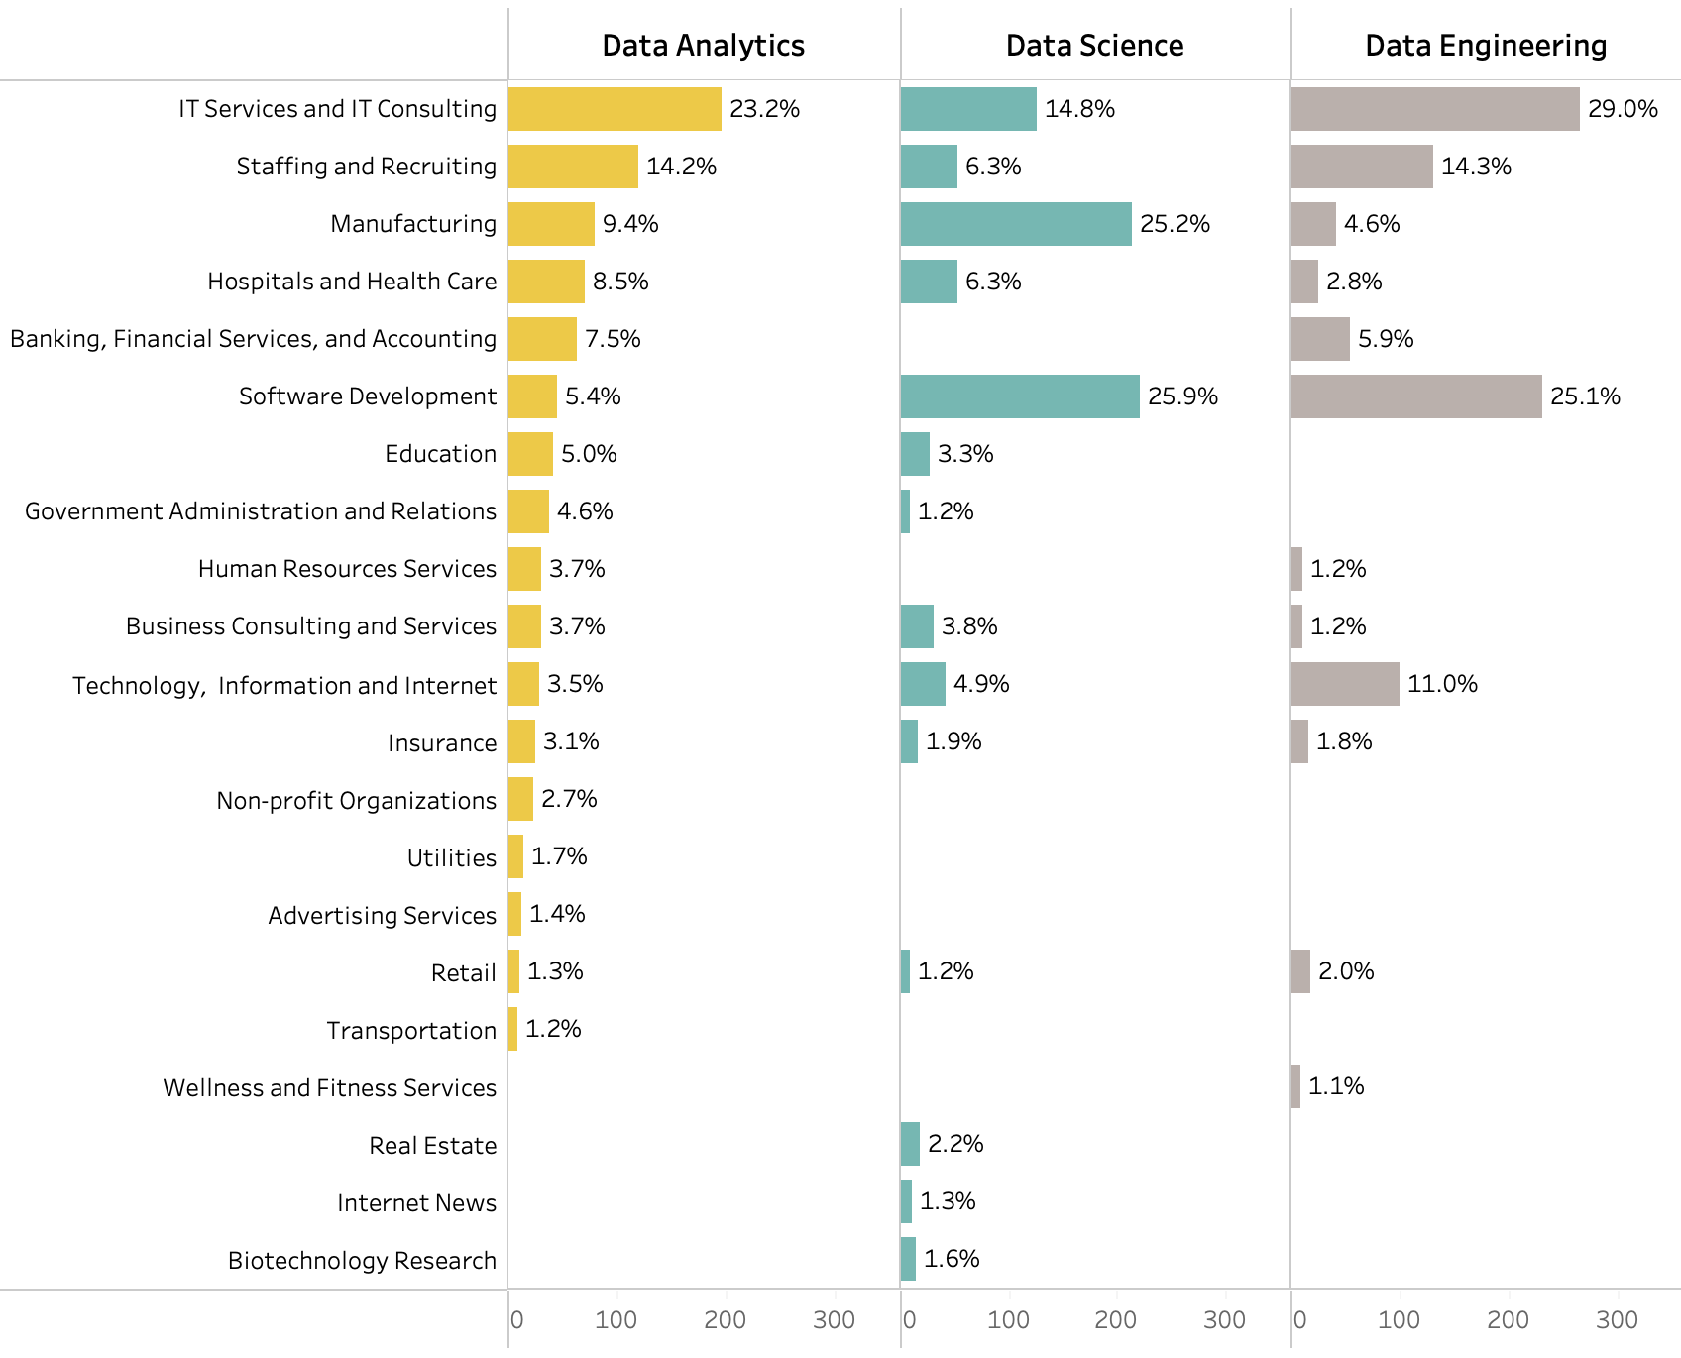
Job Market Analysis – by Industry
Business Analytics Related Full Time Job Positions by Industry in Each of the Three Domains
Note: Similar industries are consolidated into a single industry. Chart shows industries with at least 10 jobs in March 2023.

Slide 9
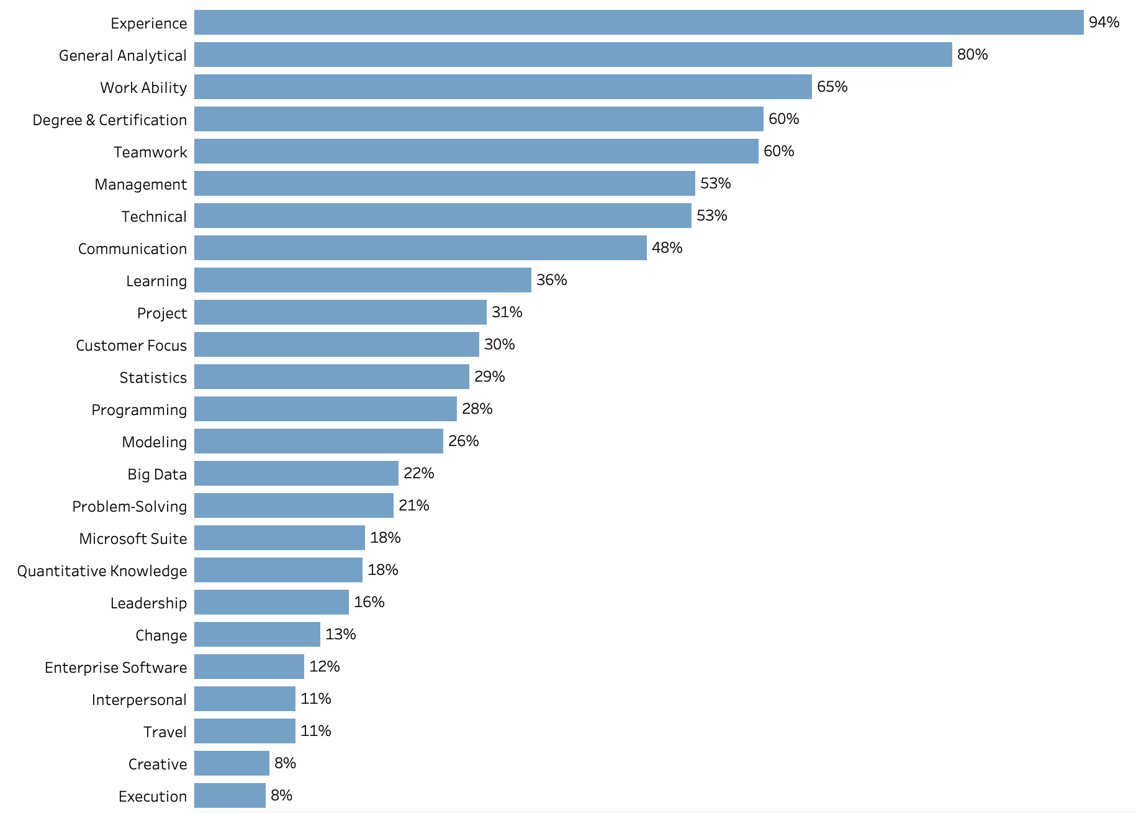
Job Market Analysis – Common Skills
Common Skills for Business Analytics Related Jobs
Note: Common skills are defined as keywords with high frequencies in job descriptions. This list of keywords is mainly based on the list obtained in the 2015 analysis. Fuzzy match was used to identify the occurrence of the common skill keywords.

Slide 10
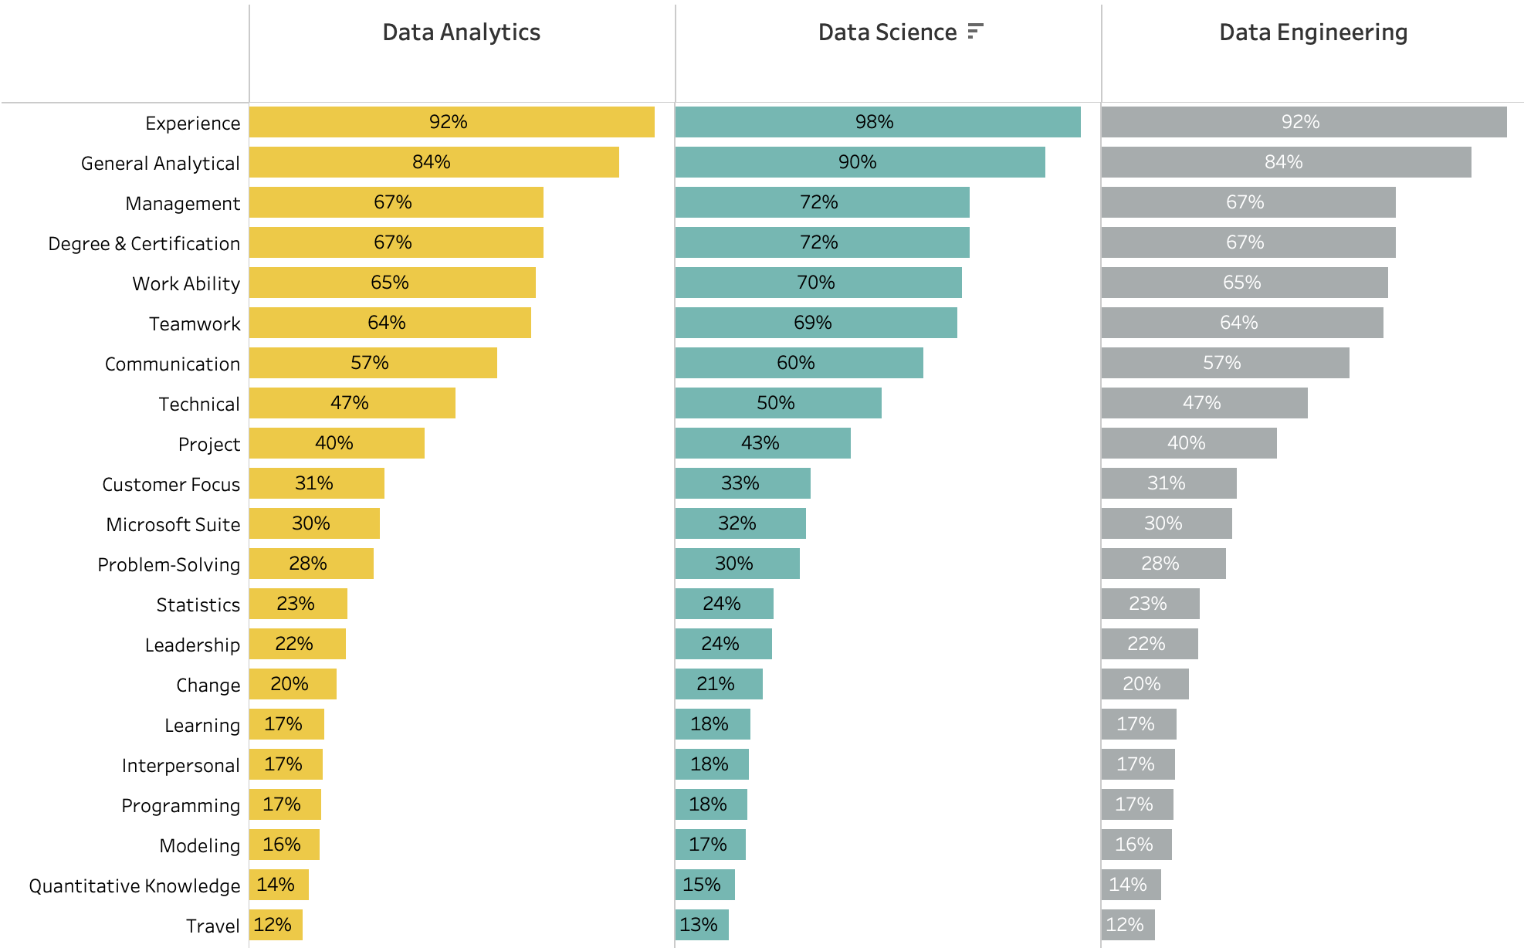
Job Market Analysis – Common Skills
Common Skills for Each of the Three Domains
Note: Common skills are defined as keywords with high frequencies in job descriptions. This list of keywords is mainly based on the list obtained in the 2015 analysis. Fuzzy match was used to identify the occurrence of the common skill keywords.

Slide 11
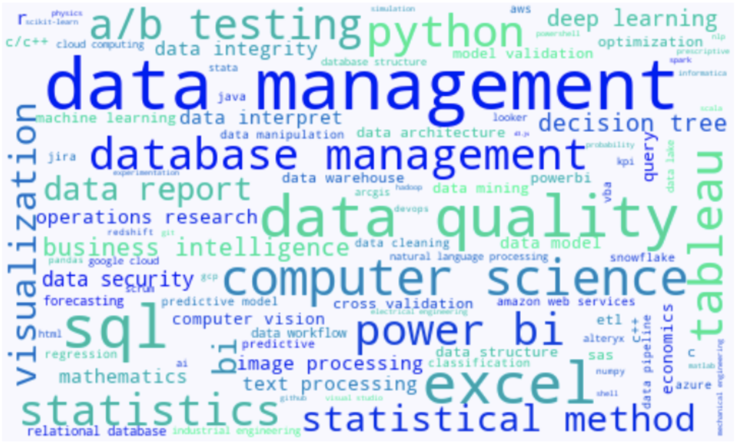
Job Market Analysis – Measurable Technical Skills
Technical Skills for Data Analytics
Note: A master list of 142 technical skills was first identified using a random sample of the job posts. Then a fuzzy match algorithm was used to identify the occurrence of the skill keywords.

Slide 12
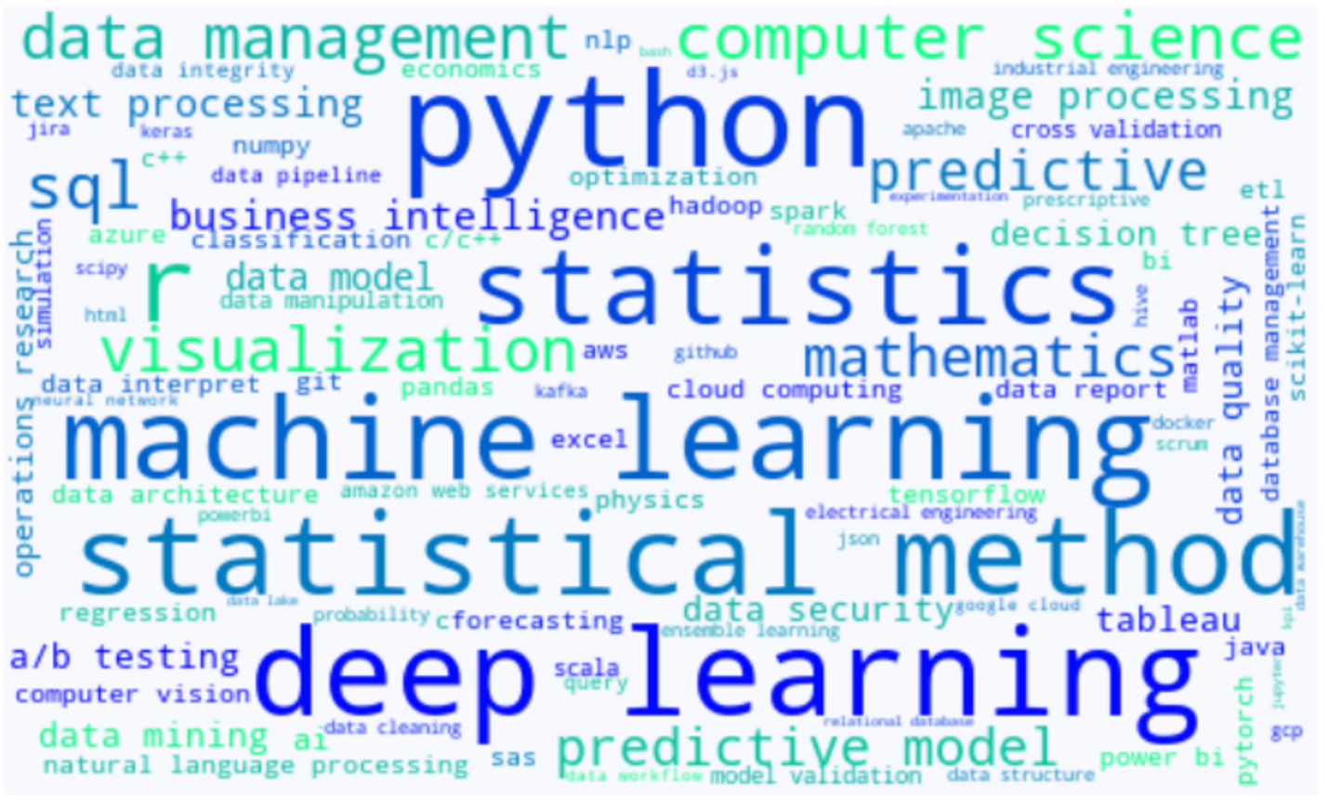
Job Market Analysis – Measurable Technical Skills
Technical Skills for Data Science
Note: A master list of 142 technical skills was first identified using a random sample of the job posts. Then a fuzzy match algorithm was used to identify the occurrence of the skill keywords.

Slide 13
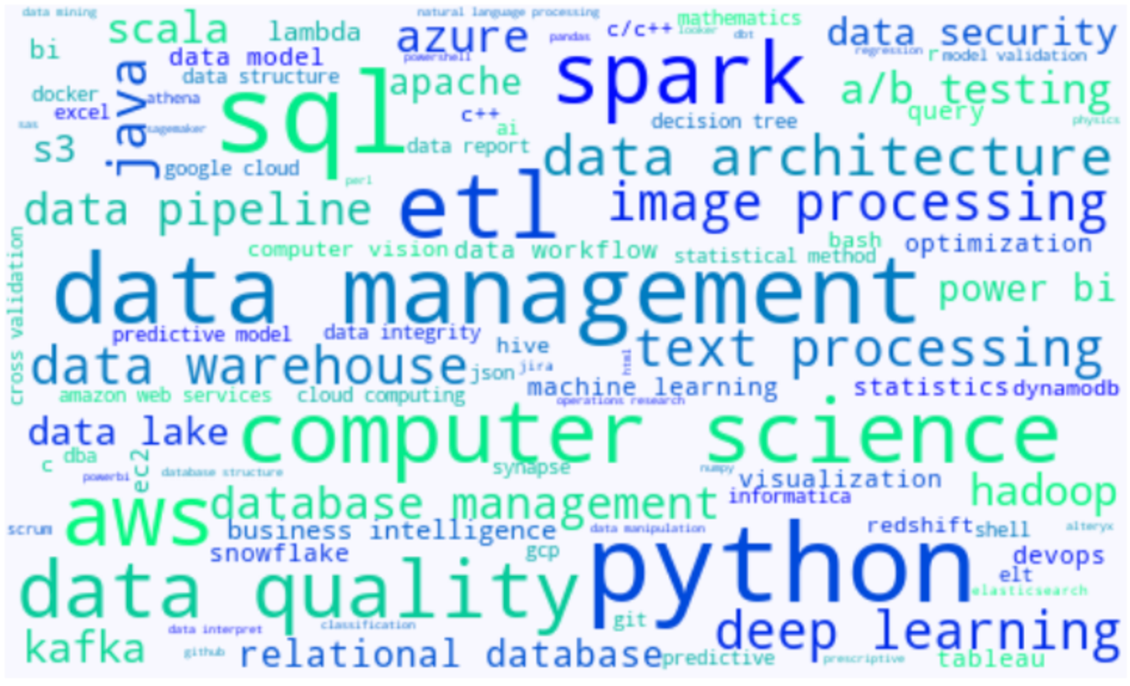
Job Market Analysis – Measurable Technical Skills
Technical Skills for Data Engineering
Note: A master list of 142 technical skills was first identified using a random sample of the job posts. Then a fuzzy match algorithm was used to identify the occurrence of the skill keywords.

